Slide 1
Microservices Fundamentals
INTRODUCING MICROSERVICES

Slide 2


Overview
What are “microservices”?
Limitations of “monoliths” Challenges of microservices Sample application

Slide 3




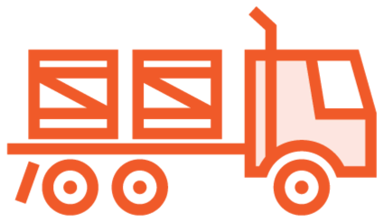
Later in This Course
Architecting microservices
Building microservices
Communicating between microservices Securing microservices
Delivering microservices

Slide 4

What are microservices?

Slide 5





Microservices
autonomous, independently deployable services…
How small should they be?
…collaborate to form an application

Slide 6
Why do we need microservices?

Slide 7

“Monoliths”
Single codebase Single process Single host Single database
Consistent technology

Slide 8

Monolith Benefits
Simplicity
One codebase
Easy to find things
Deployment
One application to replace
Monoliths are not “wrong”

Slide 9
Do you really need microservices?

Slide 10





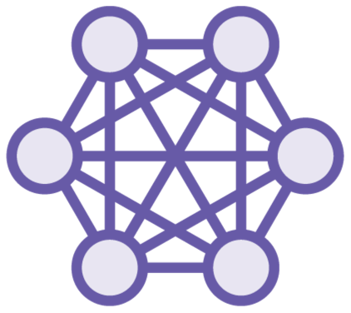
The Problem of Scale
Many developers
Many users
Monoliths can work well for small applications
Big data
Difficult to maintain
Technical debt
Entangled modules

Slide 11

Monolith Problems
Difficult to deploy
Risky
Requires downtime
Difficult to scale
Horizontal scaling often not possible
Vertical scaling is expensive
Whole application must be scaled
Wedded to legacy technology
Reduces agility

Slide 12

Distributed Monoliths
Service 1
Service 2
Everything must be deployed together
New features require changes everywhere
Shared Database
Service 3
Service 4
tight coupling

Slide 13
How are microservices better than monoliths?

Slide 14
How can microservices help us?

Slide 15
Benefits of Microservices
Small Services Can be owned by a team Easier to understand Can be rewritten
Technology Choice Adopt new technology Use the right tool
Standardize where it makes sense
Individual Deployment Lower risk
Minimize downtime Frequent updates
Scaling
Scale services individually Cost-effective
Agility Adapt rapidly Easier reuse

Slide 16
What are the downsides of microservices?

Slide 17
Microservices solve some problems, but bring new challenges

Slide 18
Challenges of Microservices
Developer Productivity
How can we make it easy for developers to be productive working on the system?
Complex Interactions
Take care to avoid inefficient, chatty communications between microservices
Deployment
You will need to automate the process
Monitoring We need a centralized
place to check logs and monitor for problems

Slide 19
You can succeed with microservices

Slide 20
Introducing the Demo Application

Slide 21
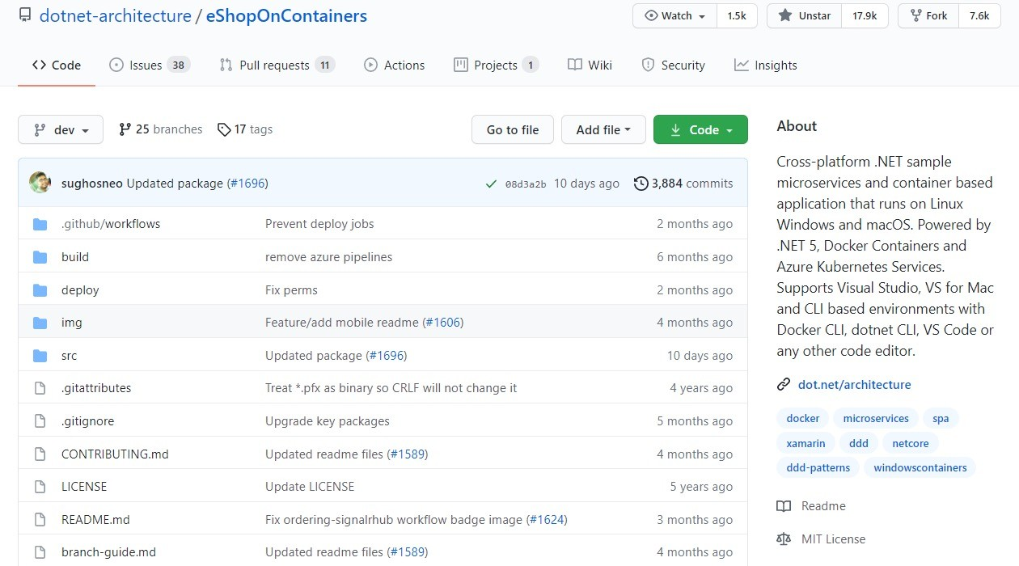
https://github.com/dotnet-architecture/eShopOnContainers

Slide 22







E-commerce
Non-trivial
Actively Maintained
Containerized
Cross-platform
Great documentation

Slide 23
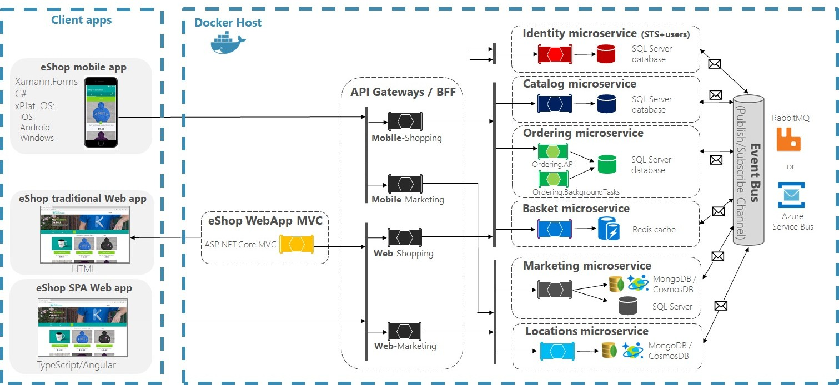
eShopOnContainers Architecture

Slide 24
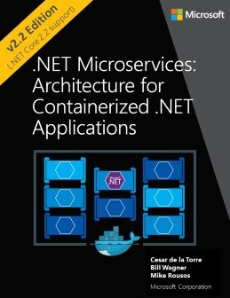
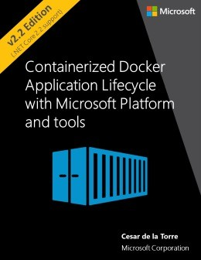
Free e-Books
https://aka.ms/microservicesebook
https://aka.ms/dockerlifecycleebook

Slide 25



Microservices Give You Choice
Microservices do not dictate technology choices
Use your favorite programming language and tools
eShopOnContainers uses .NET and Azure

Slide 26
Summary
Microservice architecture
Comparison with monoliths
Benefits over monoliths
Challenges of microservices

Slide 27
Up next…
Architecting microservices

